Slide 1

Consulting for Belvoir Dairy Limited
MA1254 – BC Group 17
Jiajun Sun Xunge Zhang
Yingzhe Sun Jihang Zhao
Notes:
Good afternoon, we are a team from the University of Leicester, UK. Our team member is 泽洲 王，奕蕾 黄，知声 韩and 迅阁 张. Today， our presentation is about Recommendations for the Treatment of Colliery.

Slide 2
CONTENTS
01
General Description
02
Operation Analysis
03
Improvement Methods
04
Recommendations and Improvements
Notes:
In this presentation, we will first describe the problem again and then analyze the mixed case and purification case under different demand situation. The order is as shown on the screen.

Slide 3
01
General Description
Speaker of this section: Jihang Zhao
Notes:
Problem description:
Belvoir Dairies Limited (BDL) is a producer of high-quality cheese for specialist cheese shops, delicatessens and similar outlets. It operates two dairies on the edge of the Vale of Belvoir (pronounced bee-vər) in North East Leicestershire, and it produces three types of cheese, Blue Belvoir, White Belvoir, Red Belvoir.
The company has invited us to examine BDL’s operations and suggest improvements.

Slide 4
Upper Basset Lower Basset
operating at about 80% capacity
Blue to be more price sensitive
Blue and White
Red
stores better
can be sold at 3-12 months
ready for sale after 9 weeks
sold within 2-3 weeks
Red
Blue and White
Blue and White must be sold at peak maturity
highly seasonal
sold at peak maturity
similar trend
lesser extent
Notes:
We know that your company’s main customers are local power stations, but your company cannot directly provide coal to meet the energy content needs of customers, so we need to improve the energy content of coal. The basic condition is as shown on the screen now.

Slide 5
02
Operation Analysis
Speaker of this section: Xunge Zhang

Slide 6
Operations that can be adjusted
01
The target levels of sales
02
03
The allocated cost of plant
The additional amount of fresh milk
Notes:
In this case, we need to take out part of the coal mine with a weekly output of 20000 tons for post-processing, and then mix the post-processing coal with the rest of the coal mine to meet customer demand.
点We calculated that we need to carry out the post-treatment of 13651.88t coal.
点The post-treatment and mixing process will cost 91433.45 pounds,
点of which the net profit is 418955.63 pounds. We found that this is better than the profit obtained by choosing any option

Slide 7
The current target levels of sales are reasonable.
Conclusion 1
The overall efficiency of plant should increase by 3 / 12 = 25% . The current efficiency of whole plant should not be greater than 100% / (1+25%) = 80%
Additional 3 million litres milk is reasonable.
Conclusion 2
the total produced amount of Lower plant is 750 tonnes,
The upper plant is 450 tonnes.

Slide 8
Additional 3 million litres milk is reasonable.
Conclusion 2
The sequence of three kind of cheese is blue: white: red.
The unit costs are Upper £7.90: £6.42 and Lower £9.30: £8.31: £7.43.
The proportion of cost associated with planning proposes are Upper 59.25%: 40.75% and Lower 30.0%: 15.4%: 54.6%.
According to the Finance part from document, the proportion of allocated costs are Upper 60%: 40% and Lower 30%: 25%: 45%.

Slide 9
Operations are reasonable
but needs to be adjusted.
Conclusion 3
The proportion of allocated cost of Upper plant is reasonable, but Lower plant’s is not, the cost of white should be decreased by 9.6% and the cost of red should be increased by 9.6%.

Slide 10
03
Improvement methods
Speaker of this section: Jiajun Sun
Notes:
Then we talk about limited demand situation for mixed case.

Slide 11
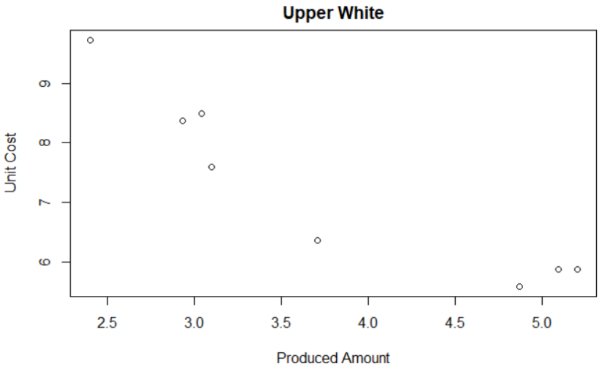
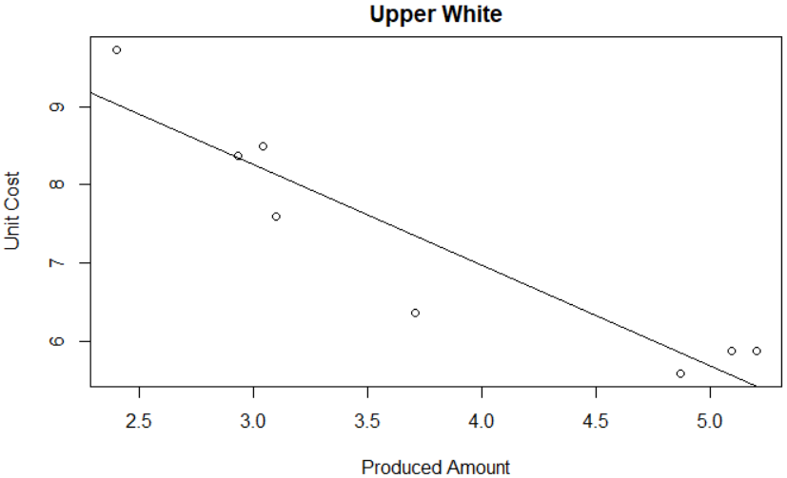

the plot of amounts and prices in Rstudio
the linear model$y= ax+b$
is not reasonable
the white cheese produced by Upper Plant

Slide 12
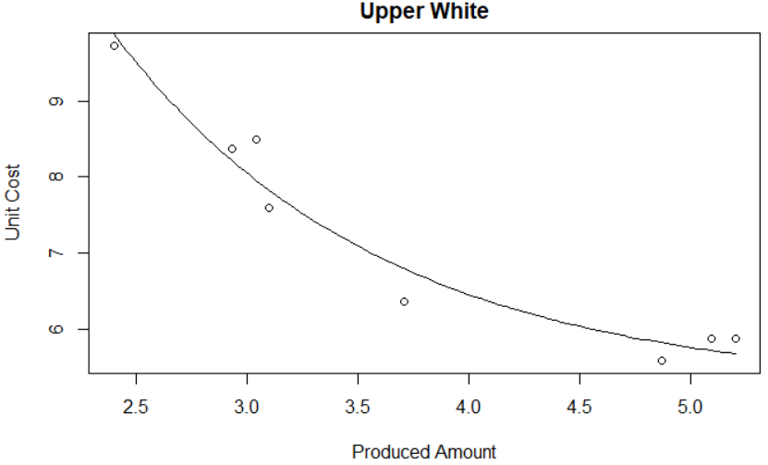
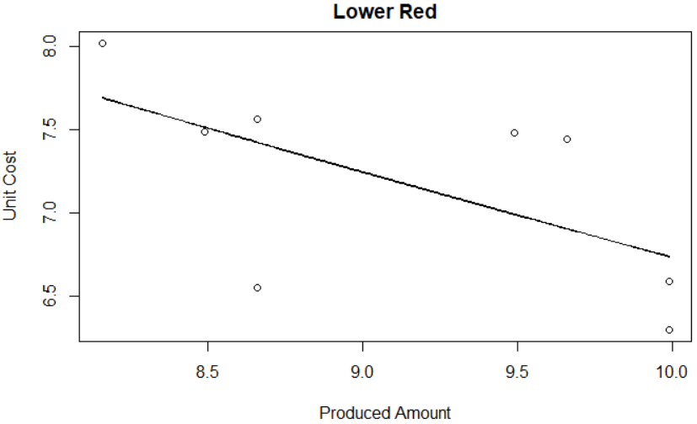

The red need more data.
Use the non-linear model
$$y=ae^{bx}+c$$
Use the simplest linear model.

Slide 13
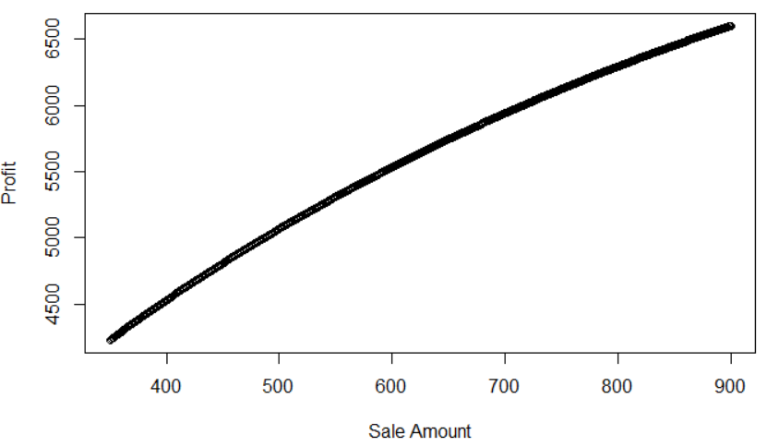


Conclusion
Produce More Blue Cheese
non-linear model
(y represents price and x represents sale amount)
$$y=−\frac{1}{0.26}\ln{\frac{x−100.22}{5827.93}}$$
①
The function of profit (p) is:
$$p=xy−0.4\left(x−450\right)$$
$$=−\frac{x}{0.26}\ln{\frac{x−100.22}{5827.93}}−0.4x+200$$
②
It is profitable to produce as much blue cheese as we can, that is, 750t.
Notes:
For the case of limited customer demand, we can analyze the situation by calculating how much profit we can get per ton of products sold.
点We can find that in this case, option 6 is the best option, with a profit of 19.73 per ton.
It should be noted that we need to ensure that this is discussed under the condition that the weekly output of coal mine is 20000 tons, that is to say, the demand of our customers should be less than 22857t, which is the minimum value after mixing among all options, so the coal mines with two options should be mixed between 22857t and 40000 tons to meet the requirements of customers.

Slide 14
04
Recommendation and Improvements
Speaker of this section: Yingzhe Sun
Notes:
For the case of unlimited user demand,

Slide 15
Improvement Plan
Producing 750t blue cheese, 300t white cheese and 450t red cheese in 52 weeks.
Red cheese can only be produced by Lower Plant.
To concentrate on red cheese, the maximal amount of Lower Plant can produce in one week is 750 / 80% / 52 = 18.03t.
It needs 450 / 18.03 = 25 weeks to produce the annual target of red cheese.
There remains 52 weeks of Upper Plant and 27 weeks of Lower Plant to produce the blue and white cheese.
From the model of the unit cost, we find that it is cheaper to produce white cheese in Lower Plant, while the unit cost of blue is roughly the same.

Slide 16
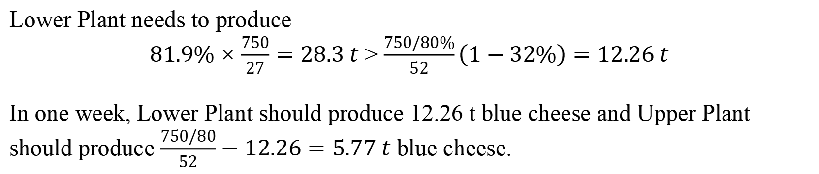
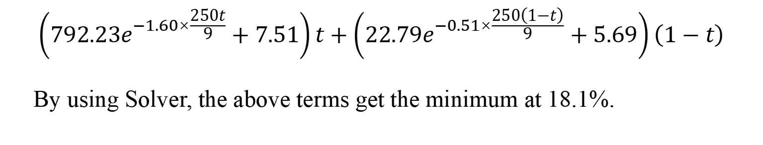
blue and white should be
launched every other week.
$$\left(792.23e^{−1.60×\frac{250t}{9}}+7.51\right)t+\left(22.79e^{−0.51×\frac{250\left(1−t\right)}{9}}+5.69\right)\left(1−t\right)$$
By using Solver, the above terms get the minimum at 18.1%.
Lower Plant needs to produce
$81.9\%×\frac{750}{27}=28.3 t$ > $\frac{750/80\%}{52}\left(1−32\%\right)=12.26 t$
In one week, Lower Plant should produce 12.26 t blue cheese and Upper Plant should produce $\frac{750/80}{52}−12.26=5.77 t$ blue cheese.

Slide 17
BDL’s operations:
adjust the proportion of allocated cost of Lower Plant from :
30%: 25%: 45% to 30.0%: 15.4%: 54.6%.
Recommandation
Odd Weeks &
Christmas-production weeks :
Upper Plant produces 5.77t blue cheese and Lower Plant produces 12.26t blue cheese and 11.11t white cheese.
Even Weeks except Christmas-production weeks:
Upper Plant does not produce cheese and Lower Plant produced 18.03t red cheese.
Notes:
BDL’s operations:
Overall great, but need to adjust the proportion of allocated cost of Lower Plant from 30%: 25%: 45% to 30.0%: 15.4%: 54.6%.
Improvement:
In first Christmas-production and odd weeks, only produce blue and white cheese at 100% capacity, and in second Christmas-production week, only produce blue and white cheese at 1-p capacity, where p is the percentage of increased needed amount of blue and white cheese in Christmas.
In even weeks, only produce red cheese at 100% capacity.

Slide 18

Thanks
MA1254 – BC Group 17
Jiajun Sun Xunge Zhang
Yingzhe Sun Jihang Zhao

